Slide 1

Vector Fields

Slide 2
How many dimensions? 2 + …

Slide 3
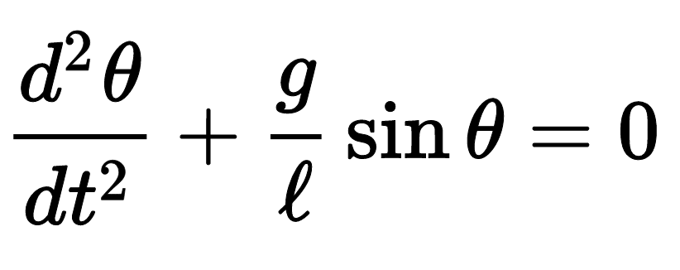
Dynamical Systems
Notes:
simple pendulum

Slide 4
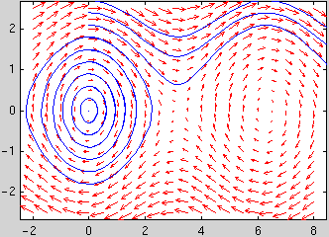
Dynamical Systems
Notes:
can be used to understand 1d, 2d (even 3d) systems
this plot from MATLAB, showing the contours of a pendulum!

Slide 5
Notes:
colors…tough!!

Slide 6
Notes:
“High Reynolds number channel flow with polymer additives”
show surfaces where the shear stress is constant

Slide 8
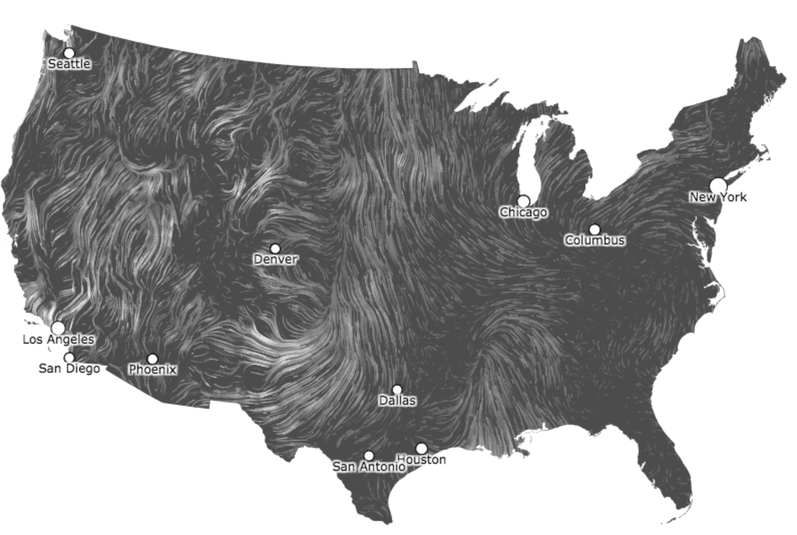
Notes:
with animation, don’t need the directionality

Slide 9


